Slide 1
“DevOps” Project with security penetration testing integration
Serhij Zyuzko

Slide 2
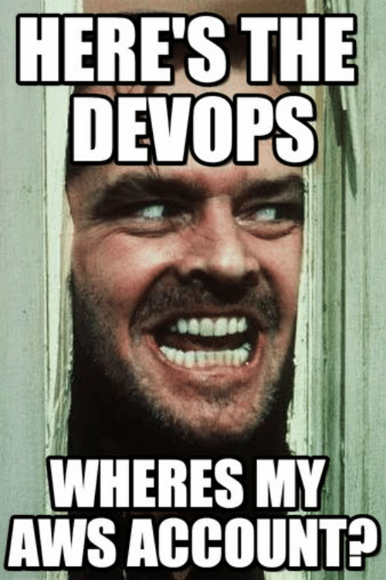
My project realisation
AWS
JENKINS
ARCHERYSEC
OWASP JUICE-SHOP

Slide 3

PYTHON
PYTHON

Slide 4
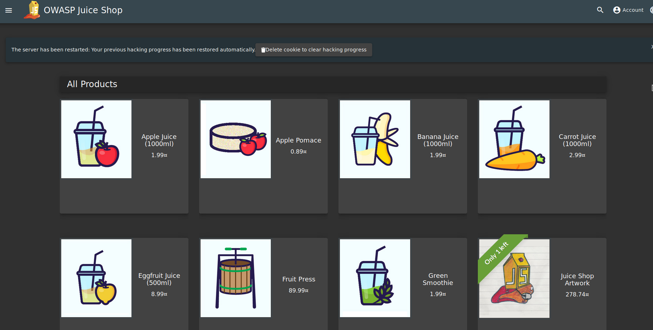
JUICE SHOP
Advantages:
+ Easy to install
+ Lightweight
+ Vulnerable
+ SAST integration

Slide 5
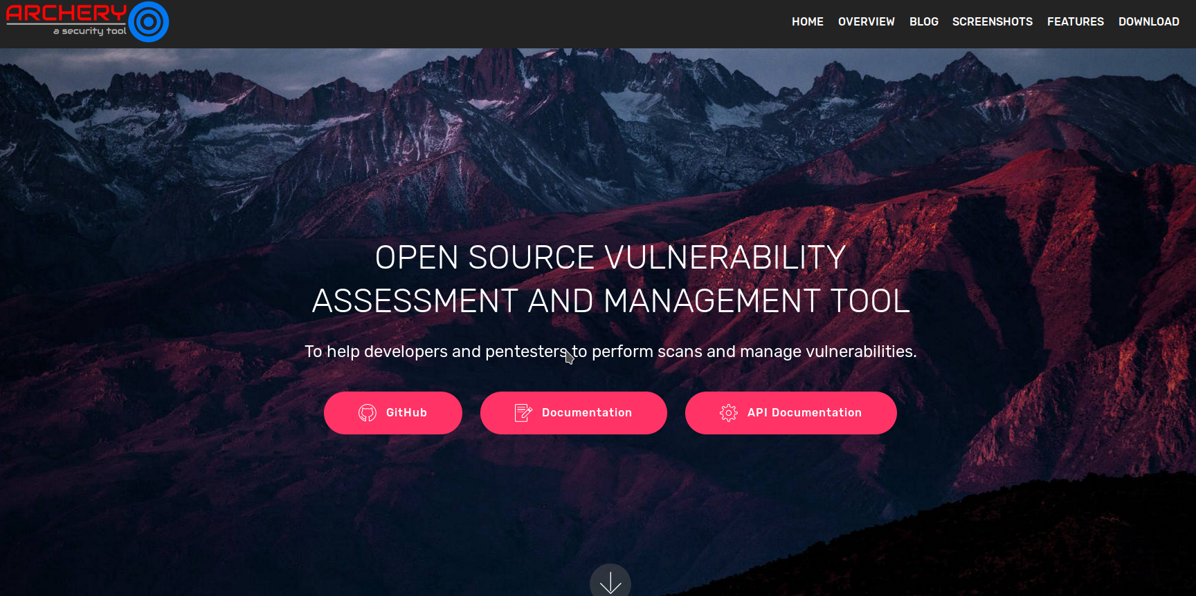
ArcherySec
Advantages:
+ Cool pentest tools integration Arachii, ZAP
+ Infrastructure scan tools Nessus, OpenVas
+ Advanced SAST scanning tools Bandit FindBug
+ Python API
+ Easy to understand reports

Slide 6
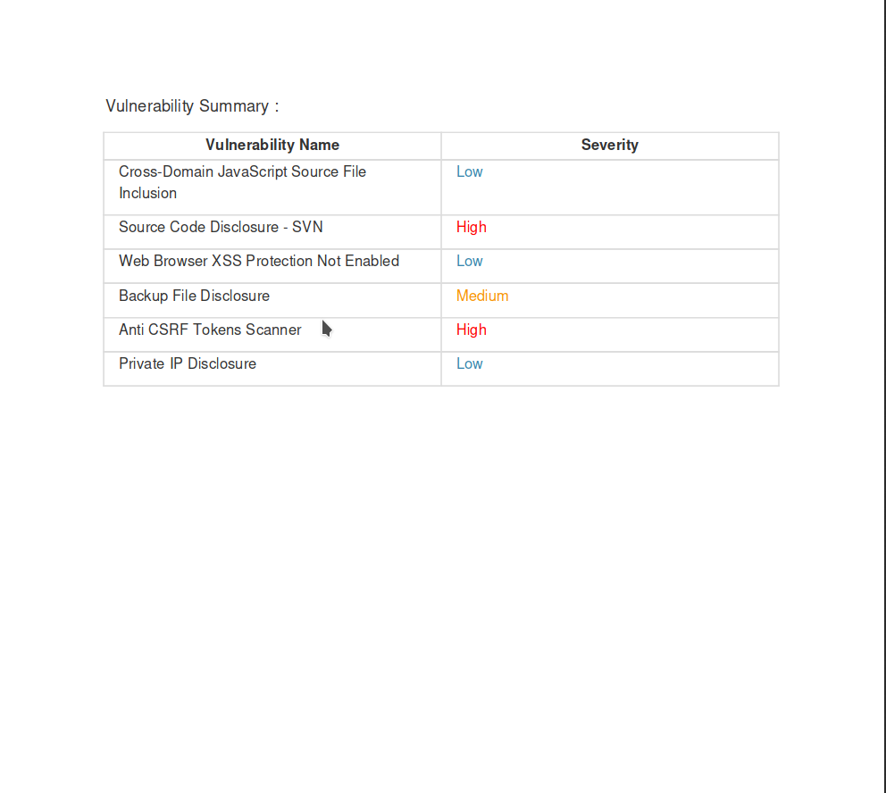
+ Cool reports, which I wasn’t able to pull from Archery)

Slide 7
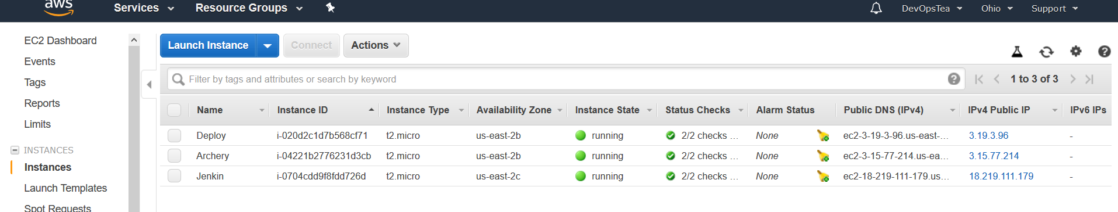
AWS infrastructure

Slide 8
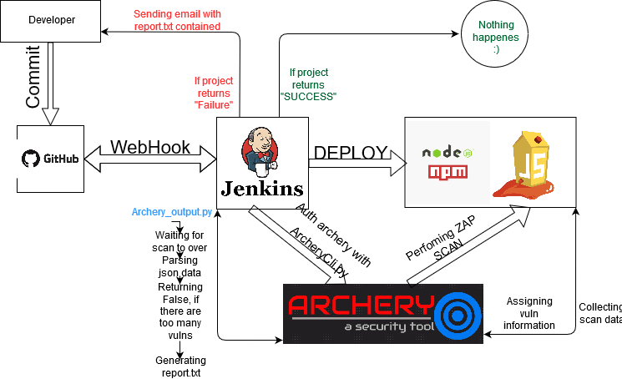
My project scheme

Slide 9
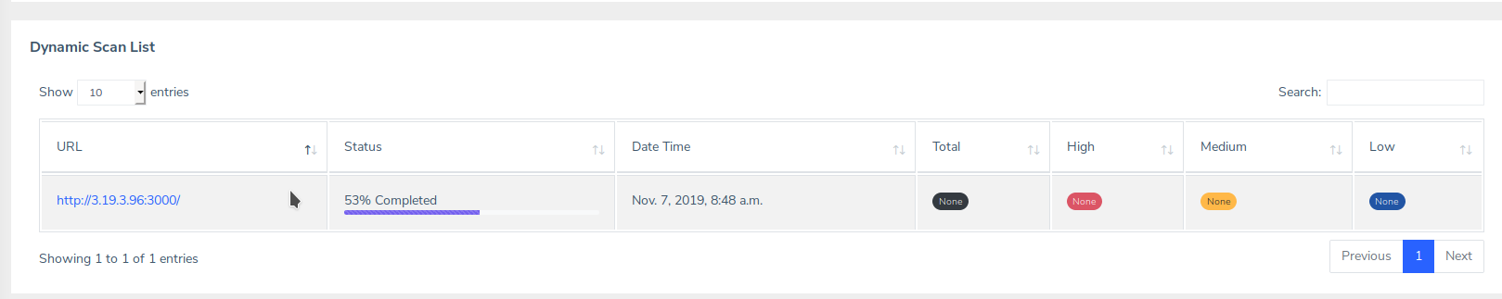

Slide 10
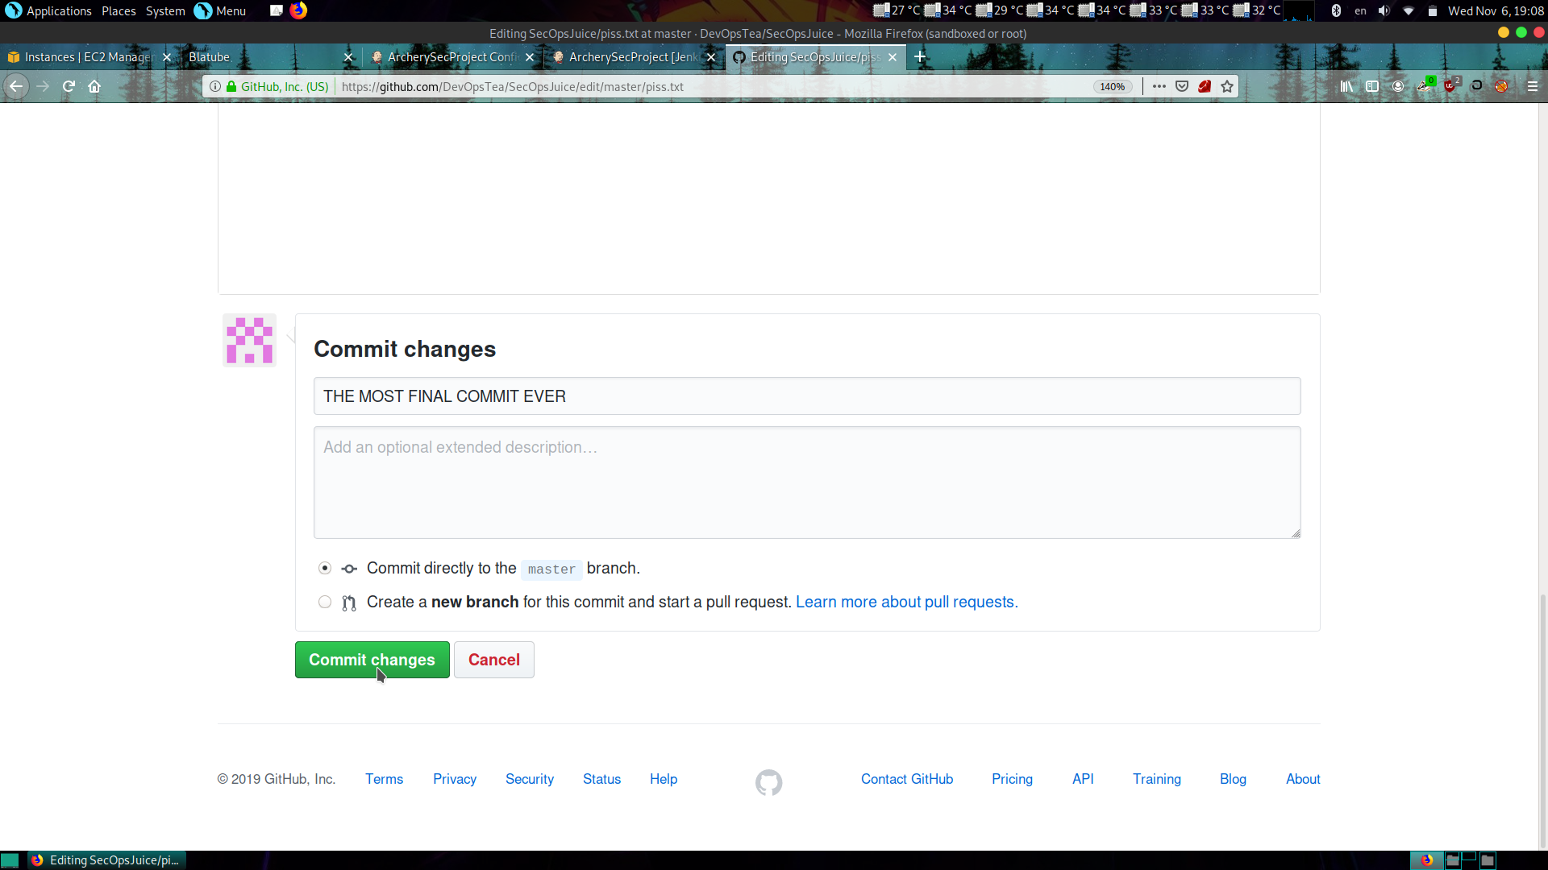
WebHook Integration

Slide 11
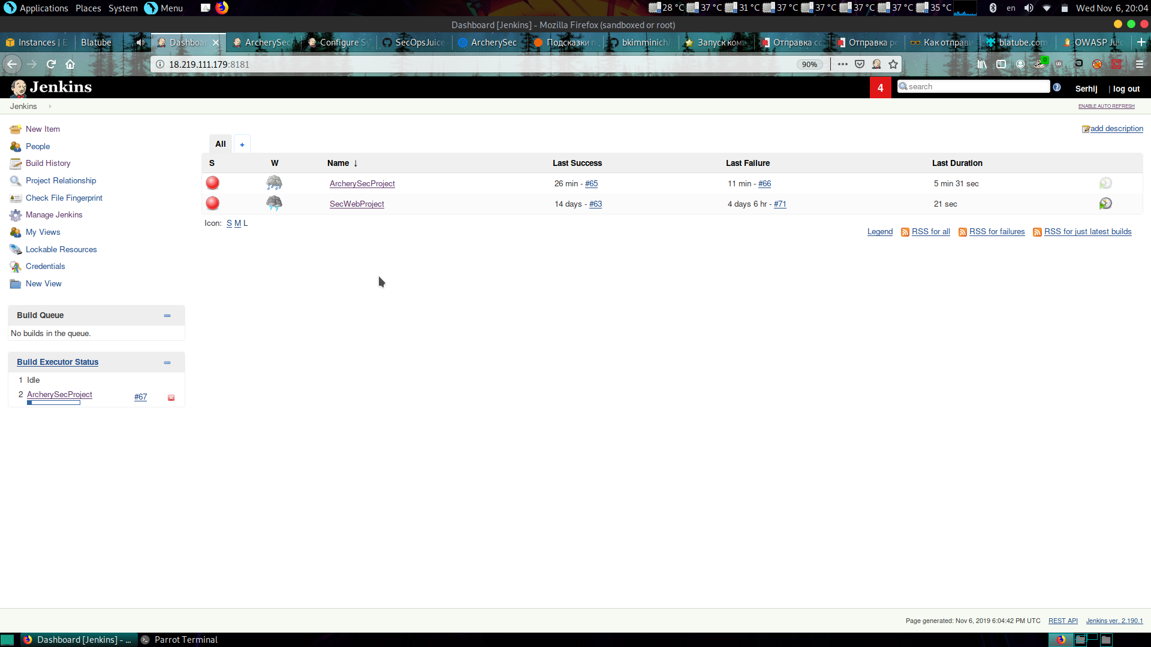
Jenkins JOB

Slide 12
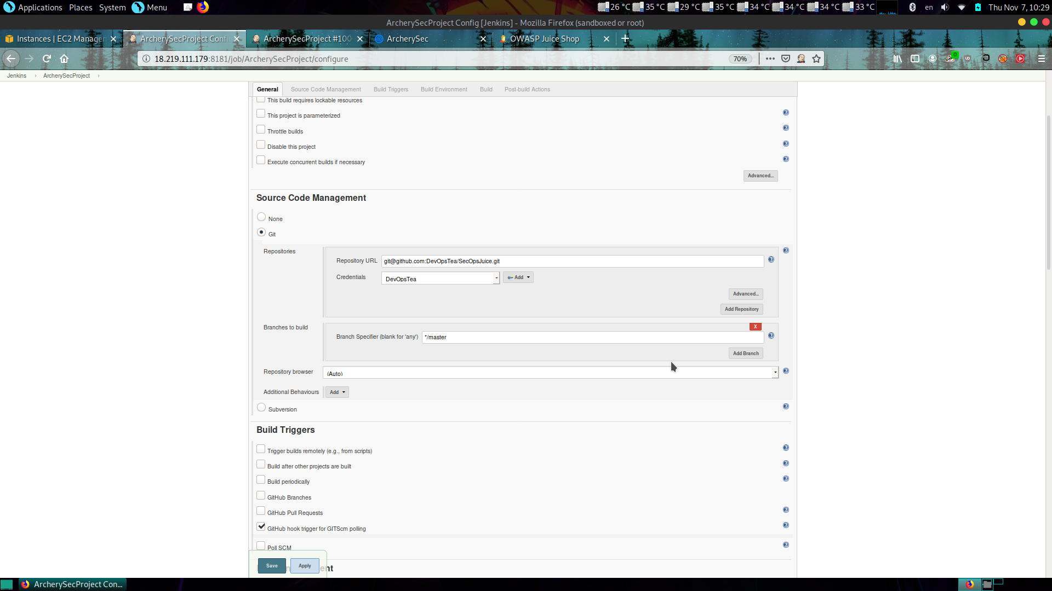
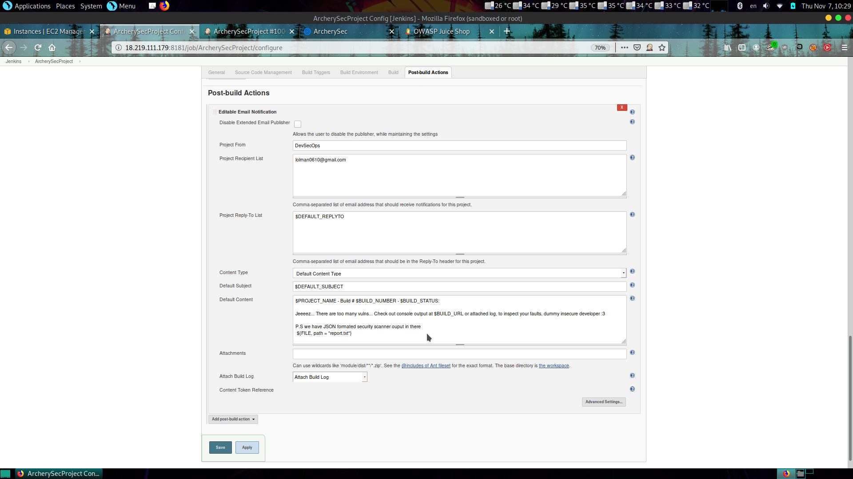
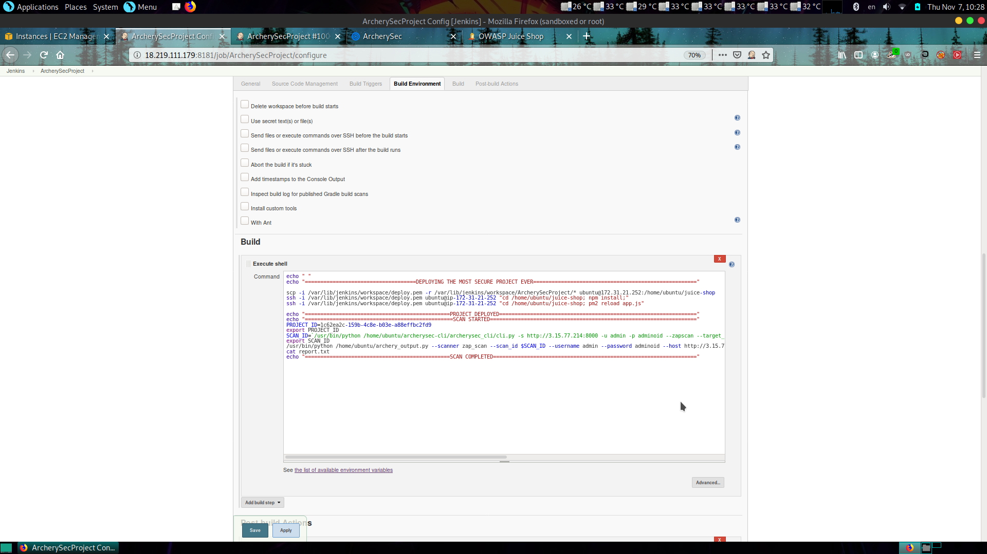
PIPELINE

Slide 13
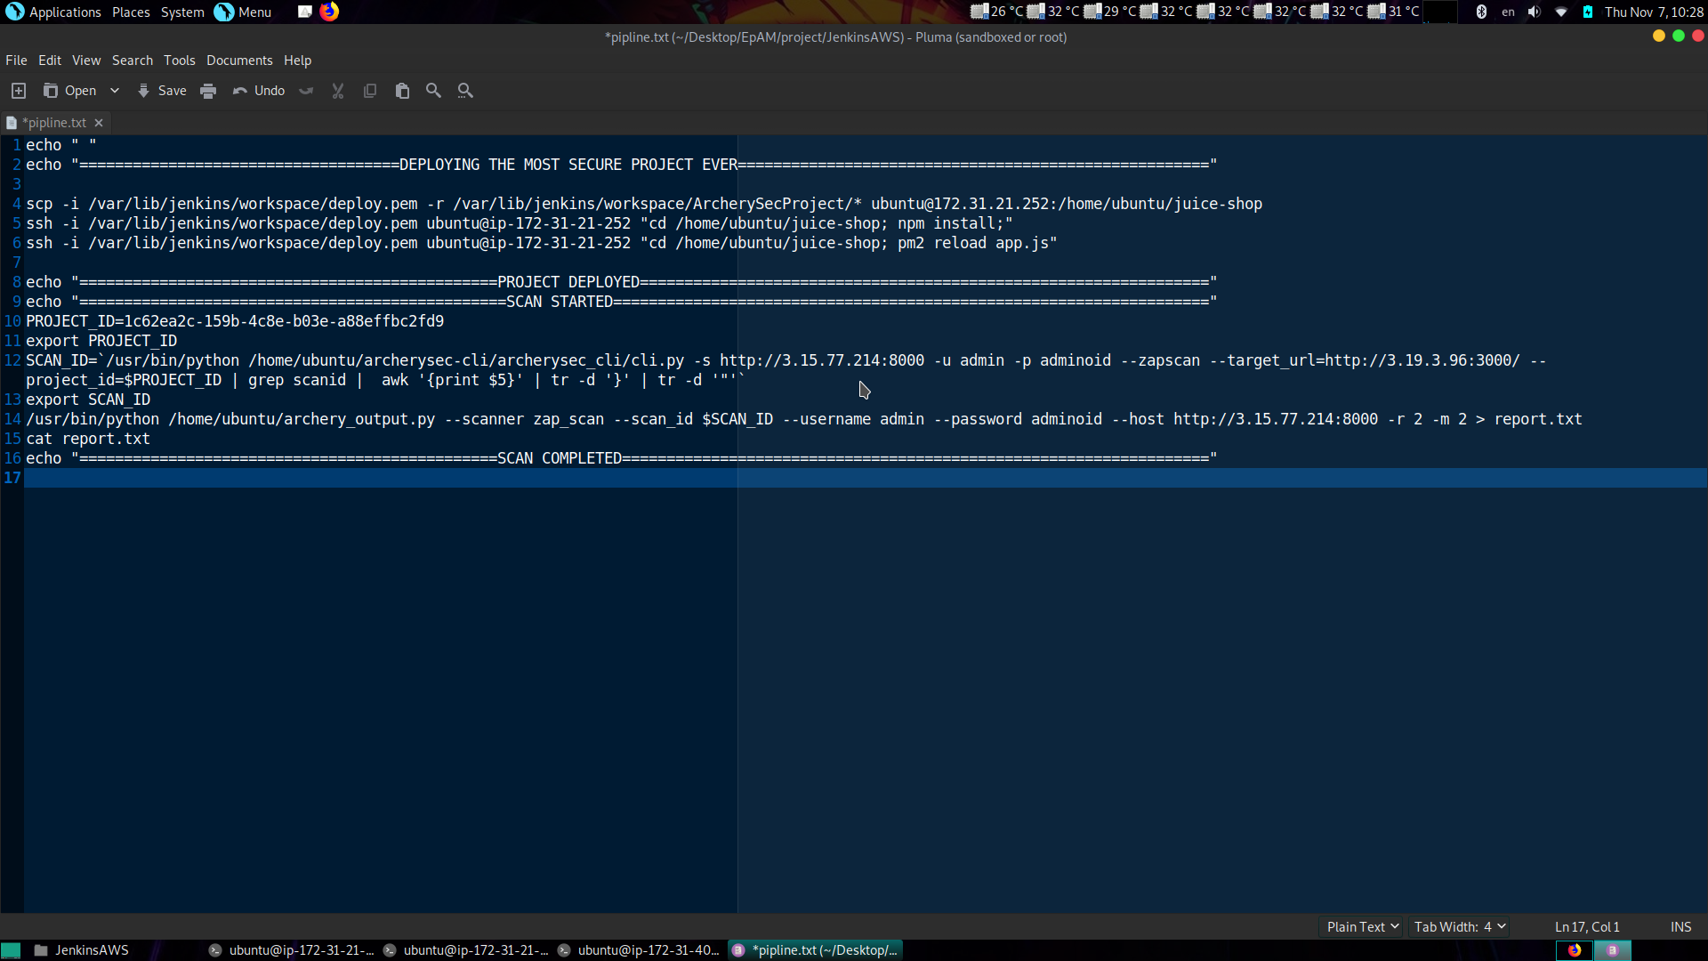
EXECUTE SHELL STEP

Slide 14
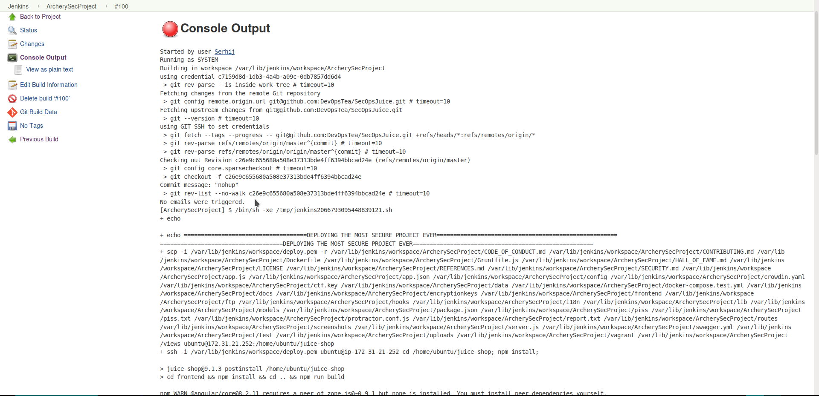
Console Output

Slide 15
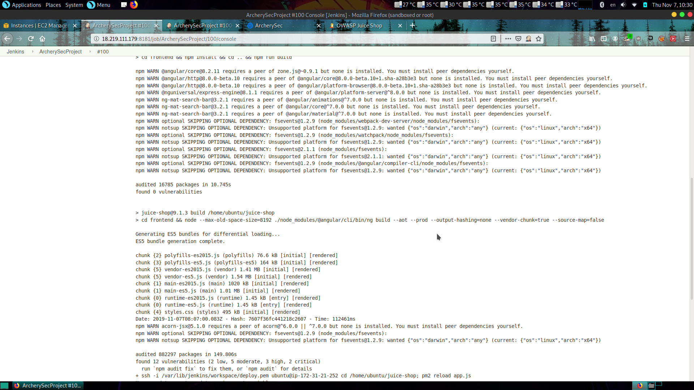
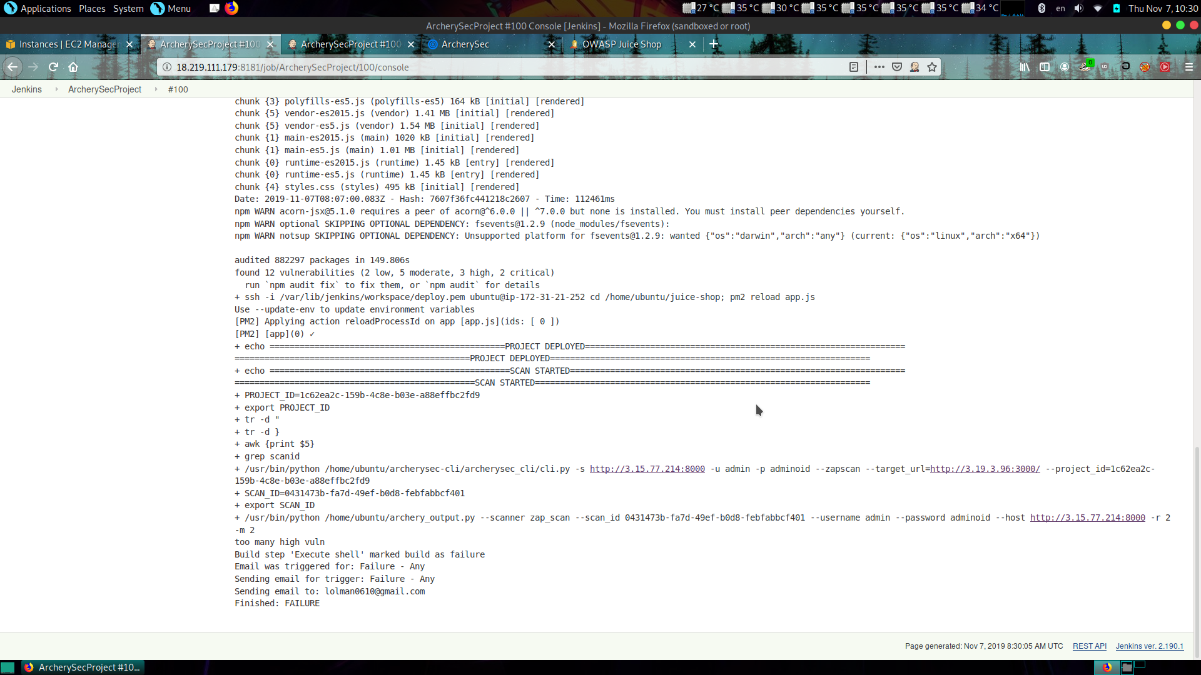
Still console output

Slide 16
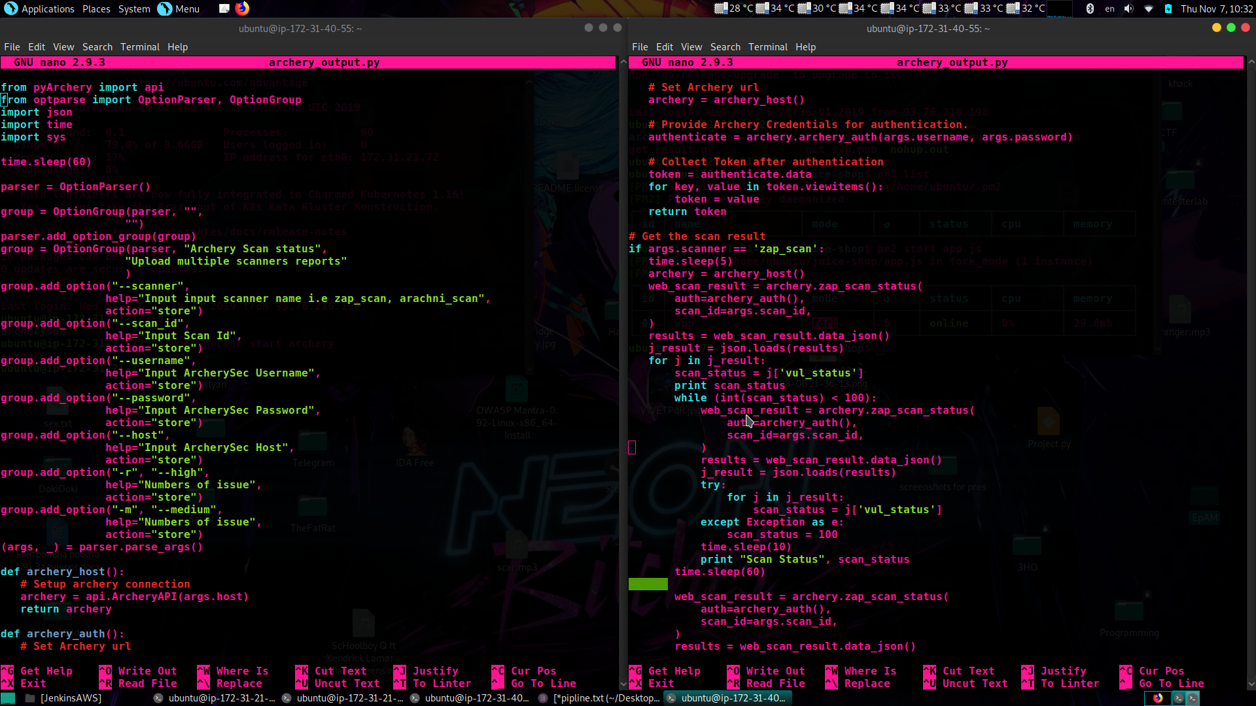

Slide 17
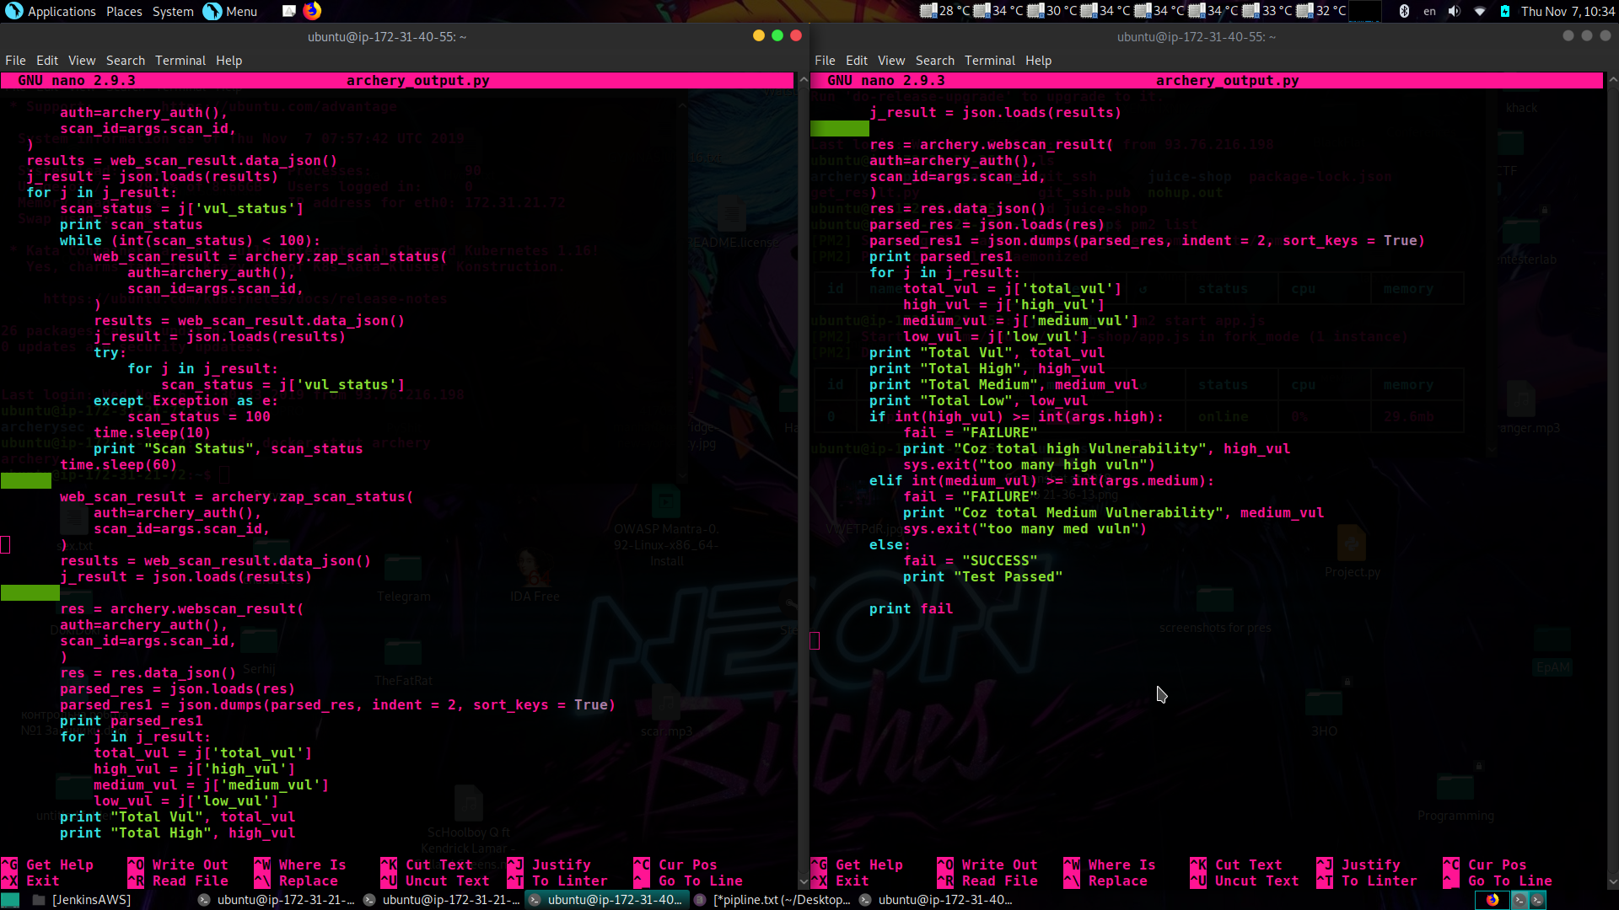

Slide 18
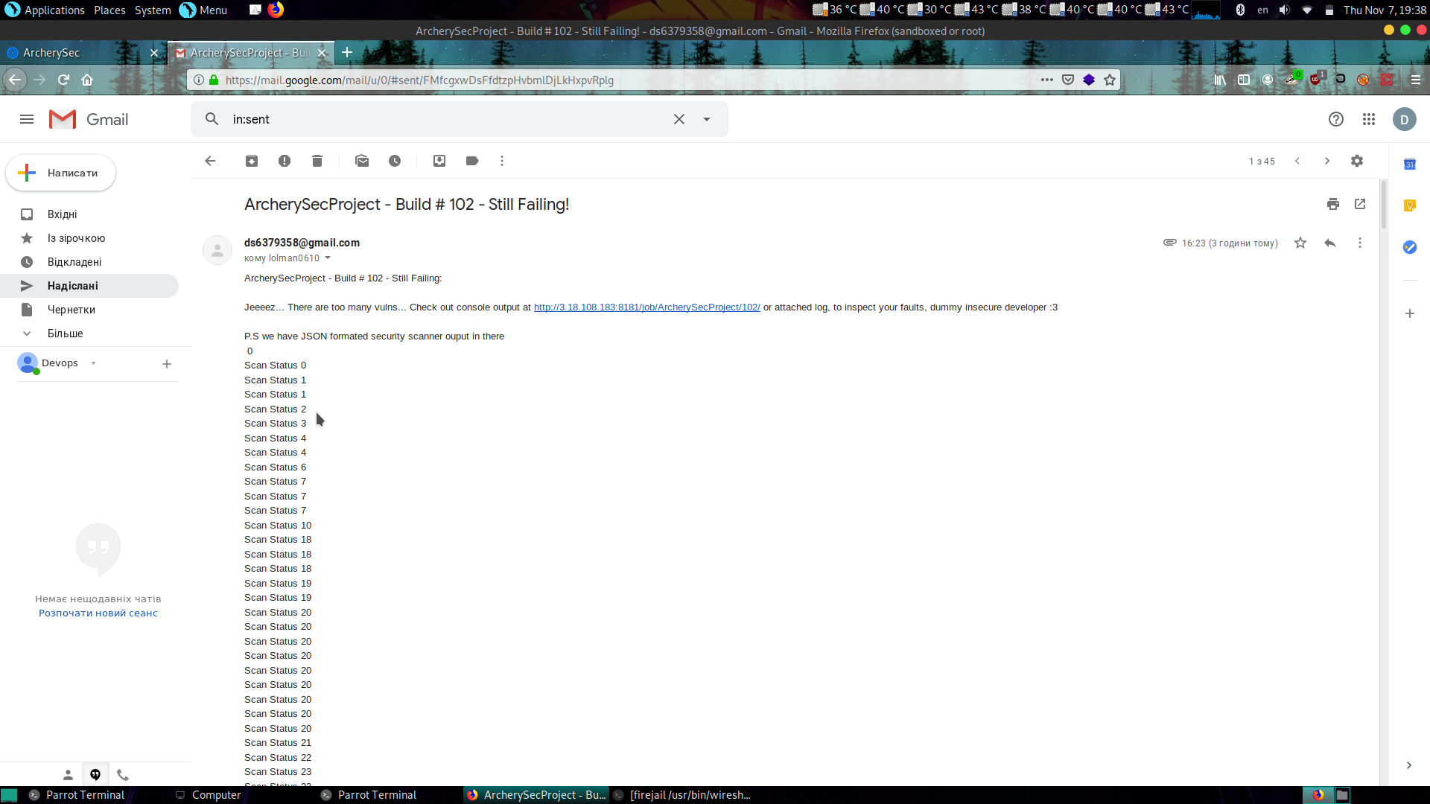
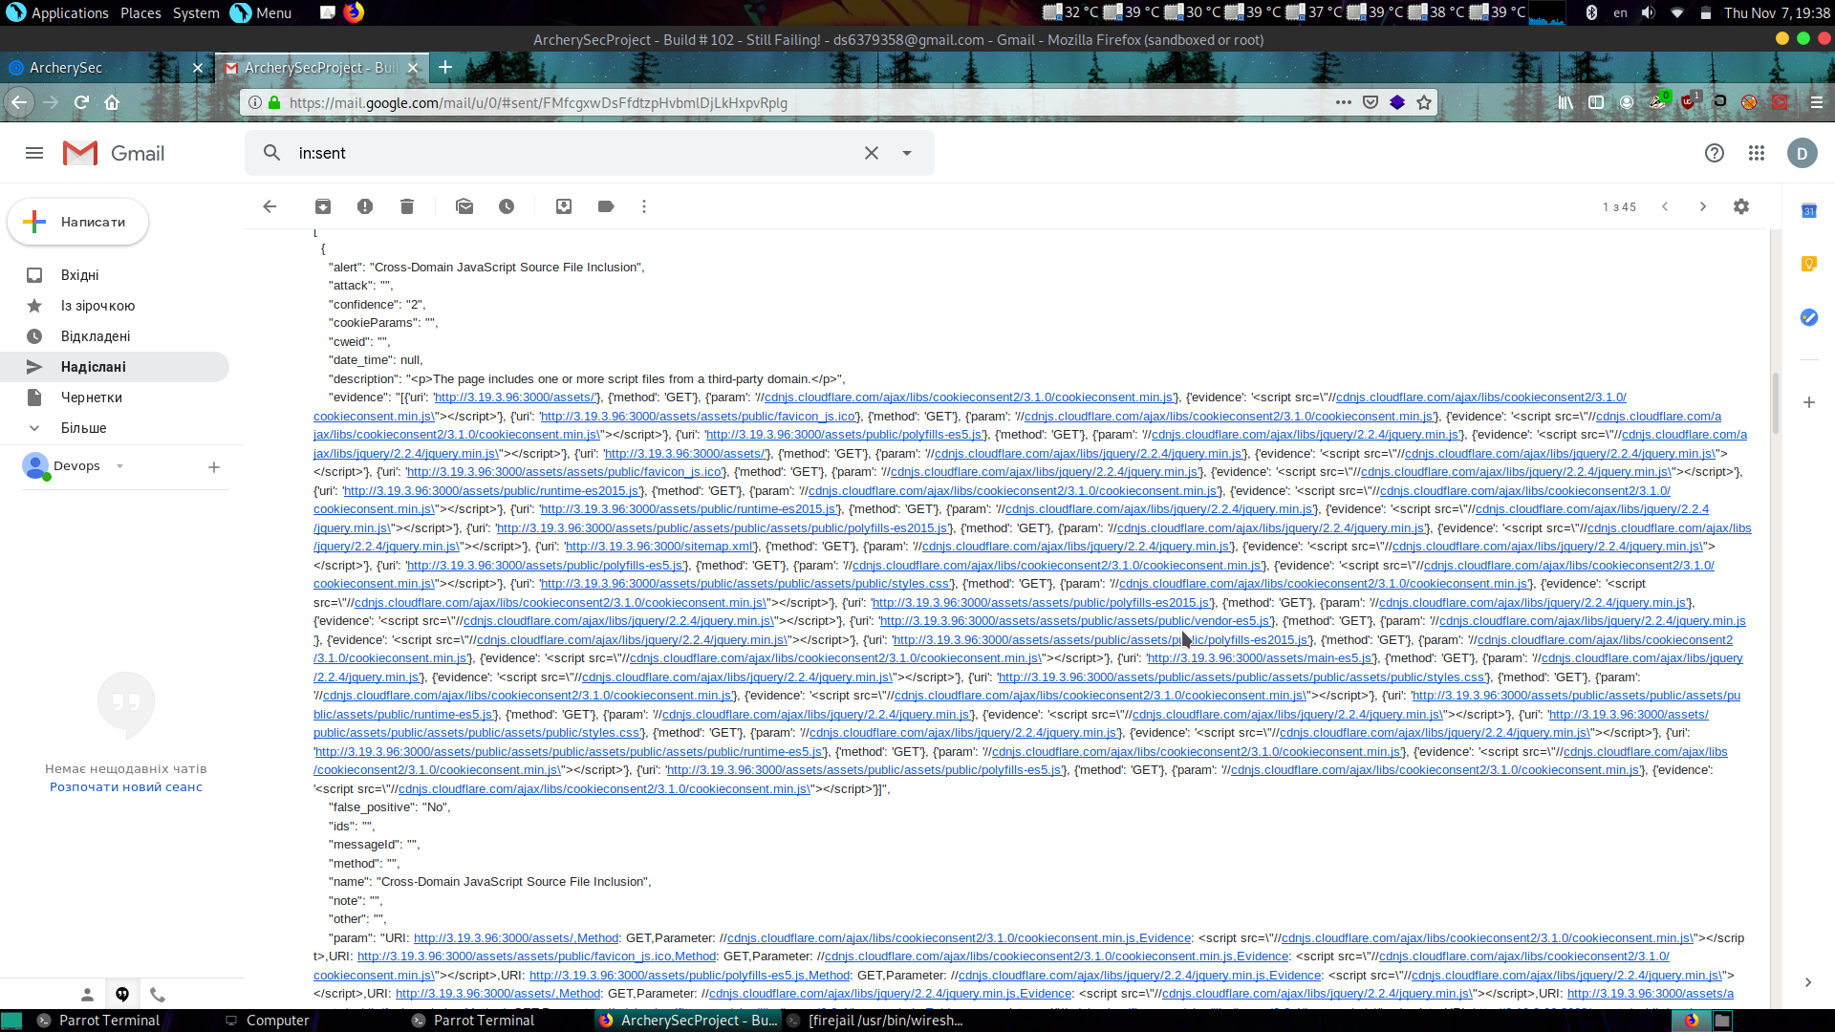
Email notification

Slide 19
Disadvantages
Project can failure not because plenty of vulnerabilities are found
You need to enter manually project_id param, to allow archerycli.py auth with archery
Job lasts for 10 minutes
Better work with php based projects

